Slide 1
Hitchhiking 101

Slide 2
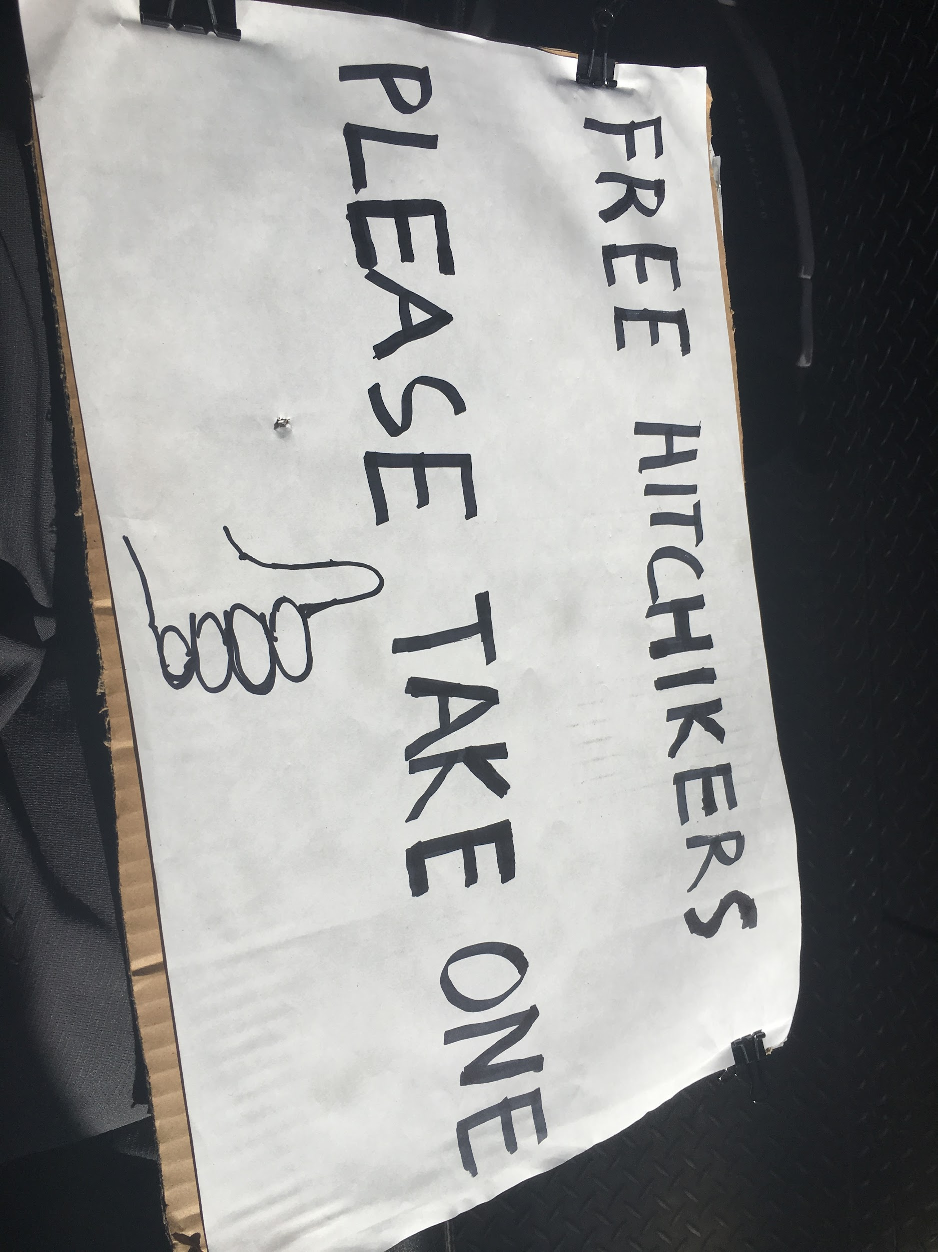

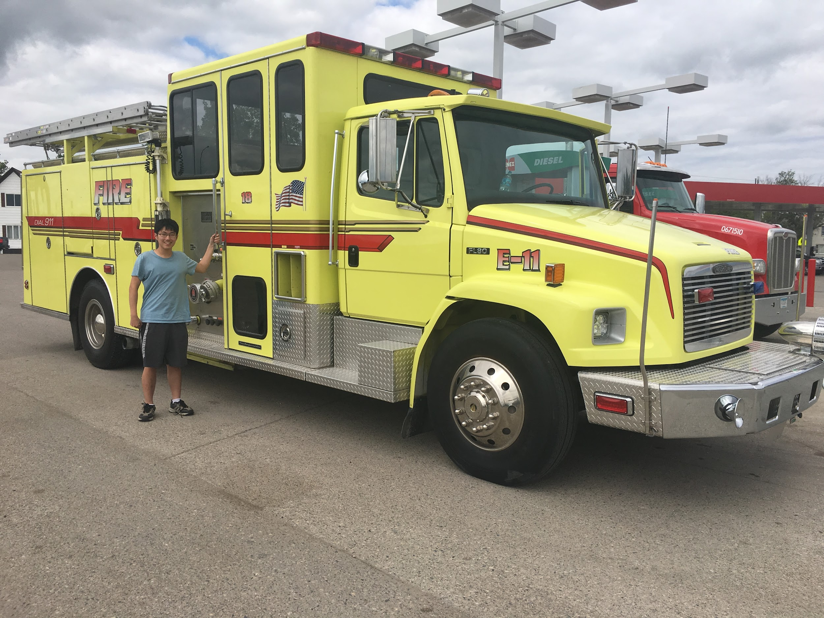
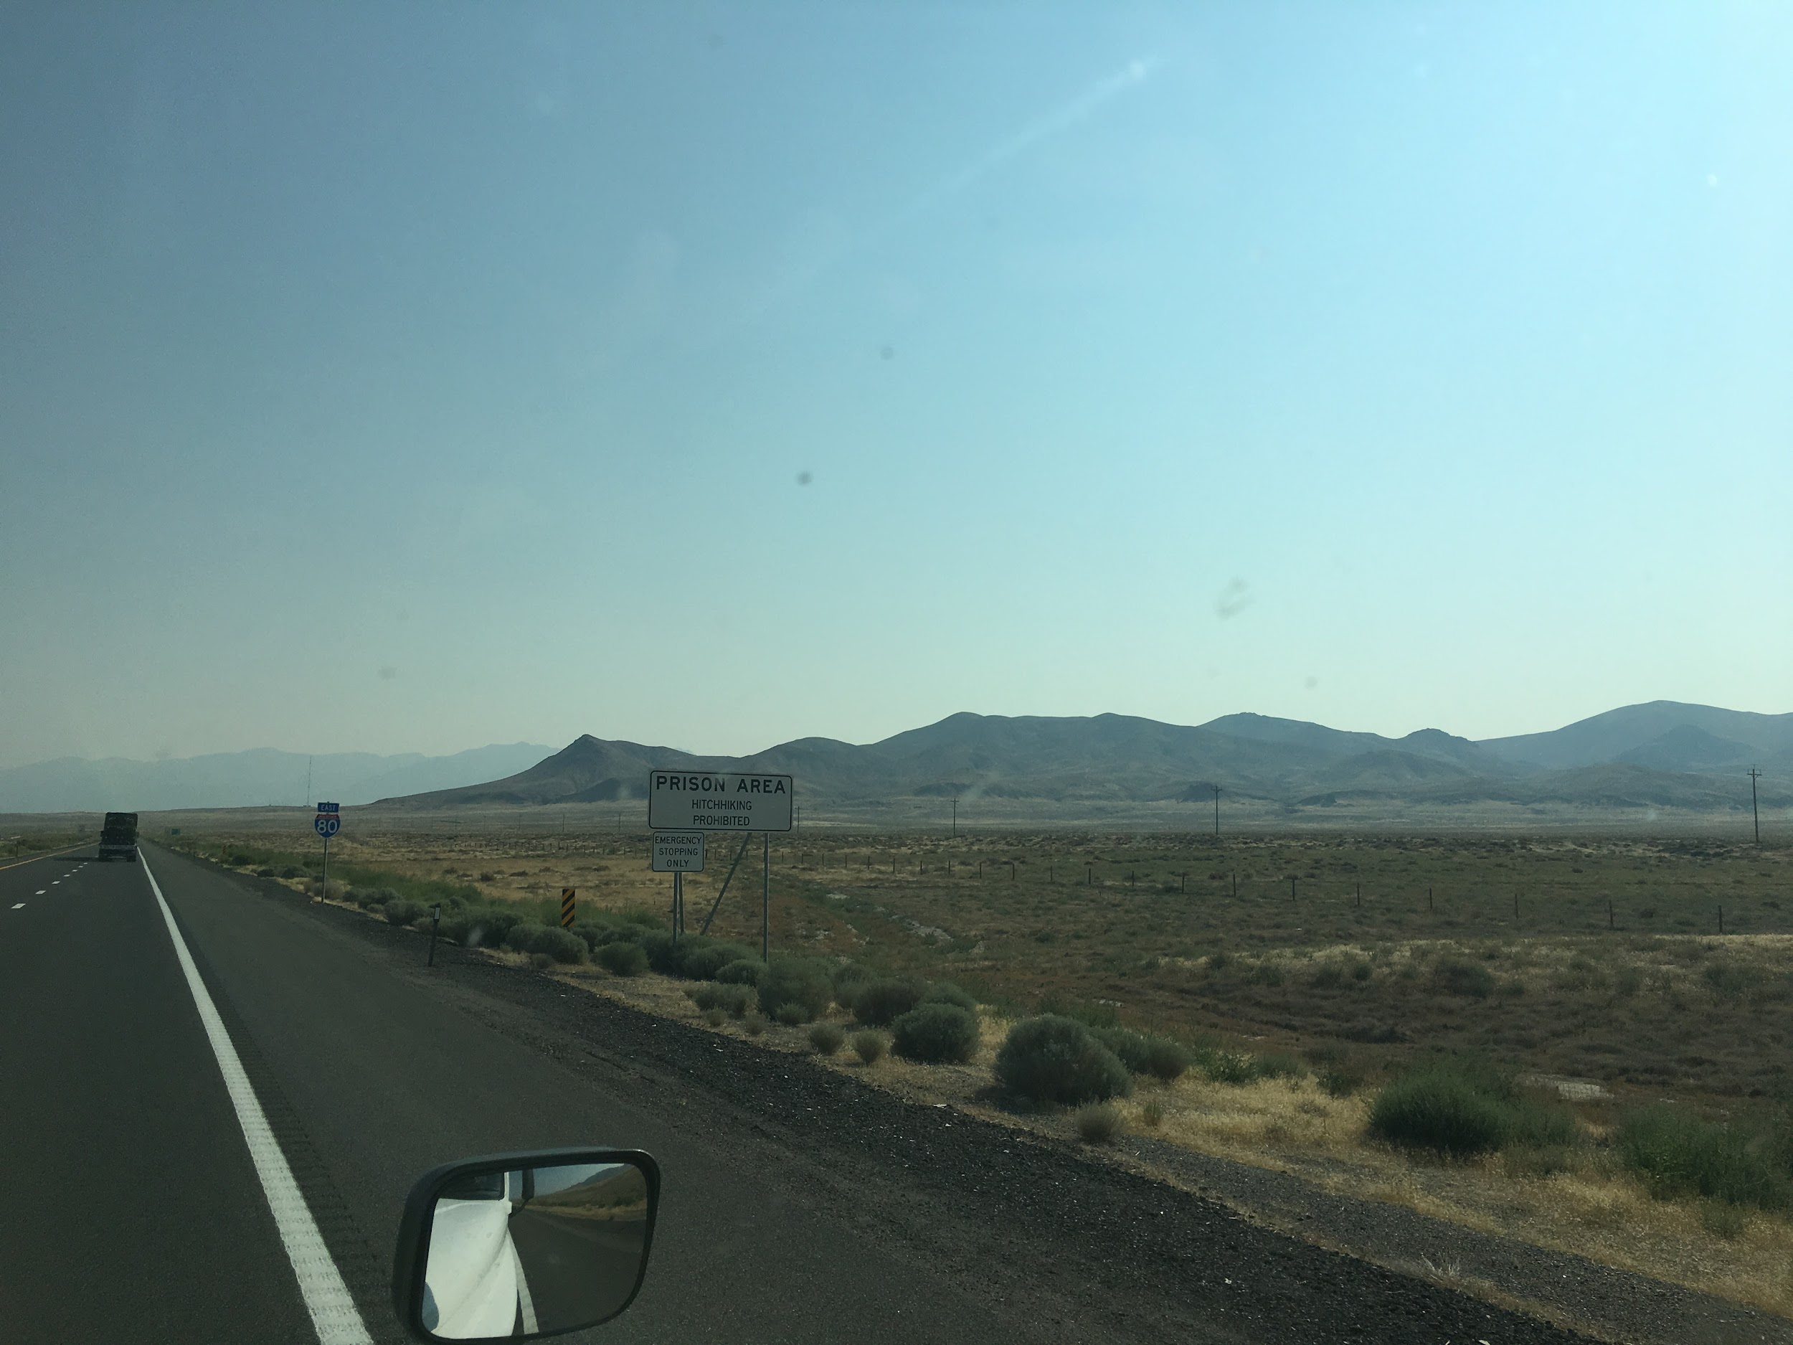

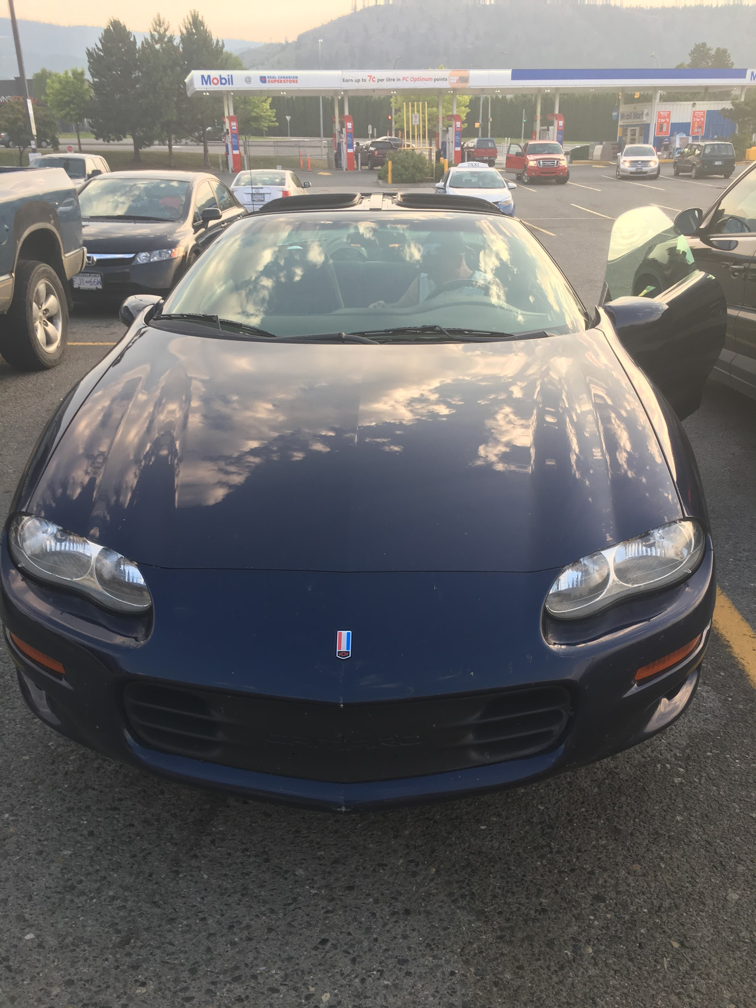
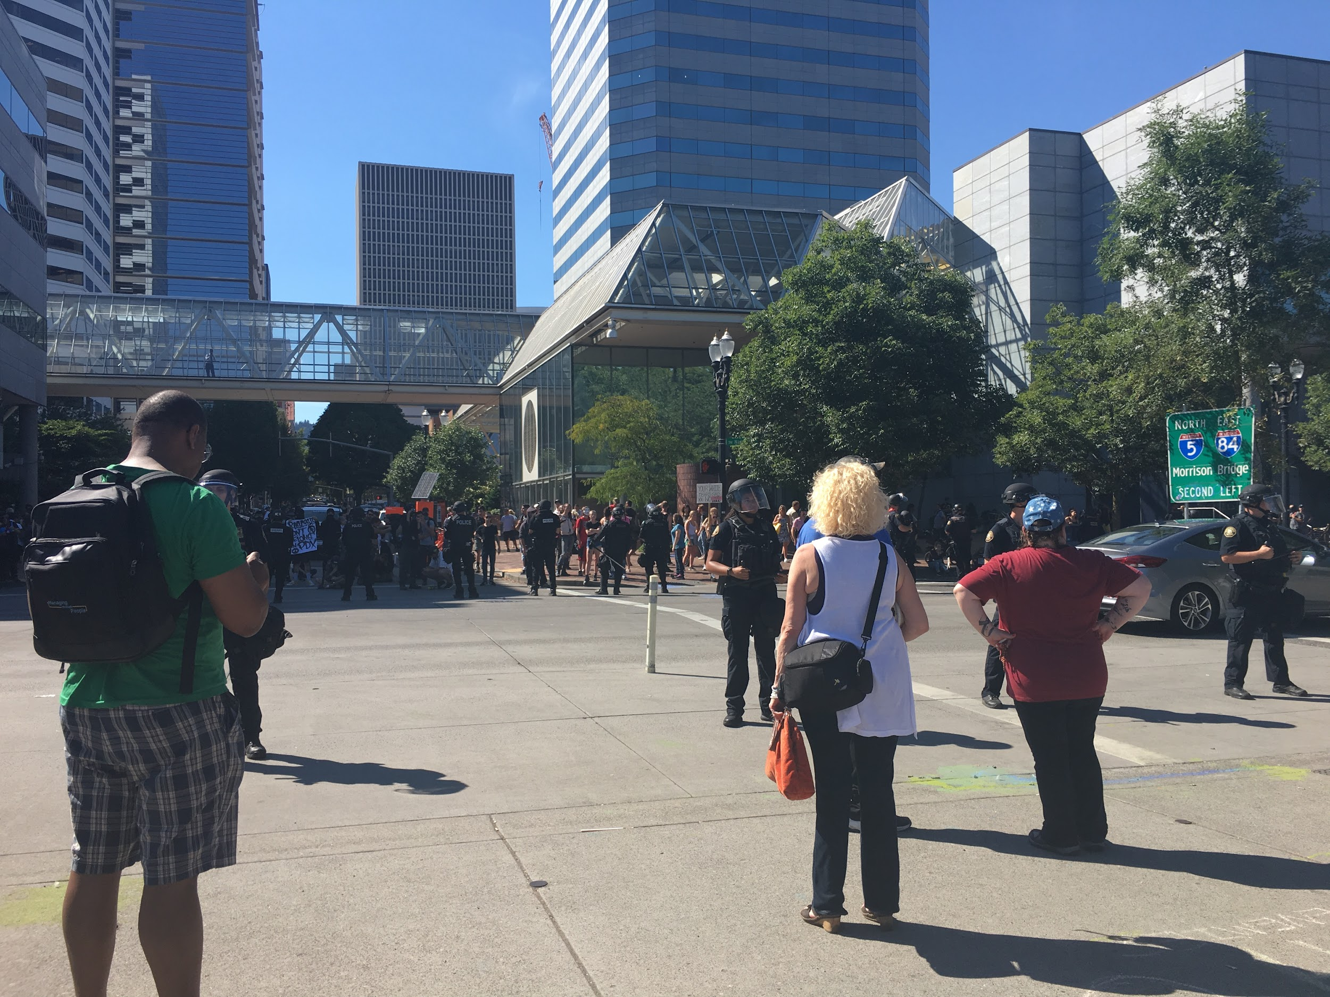
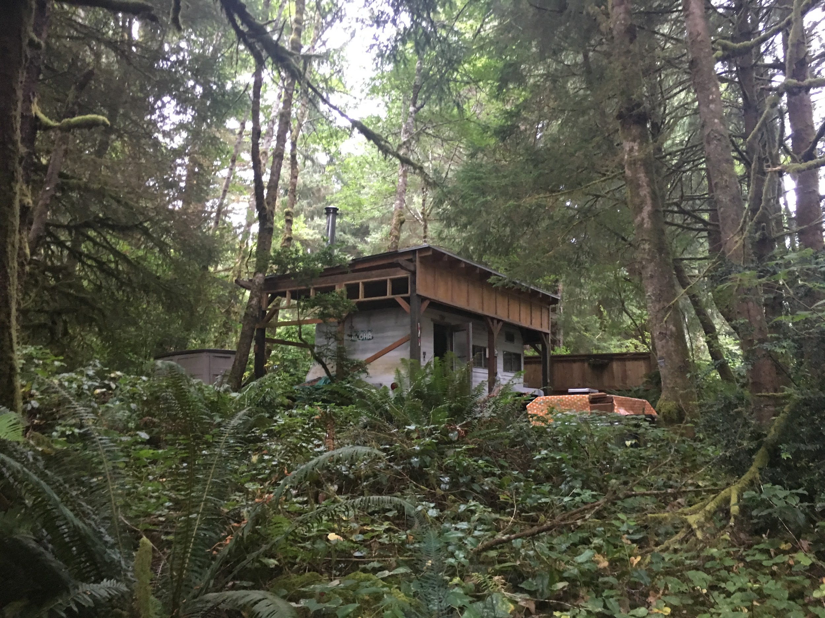
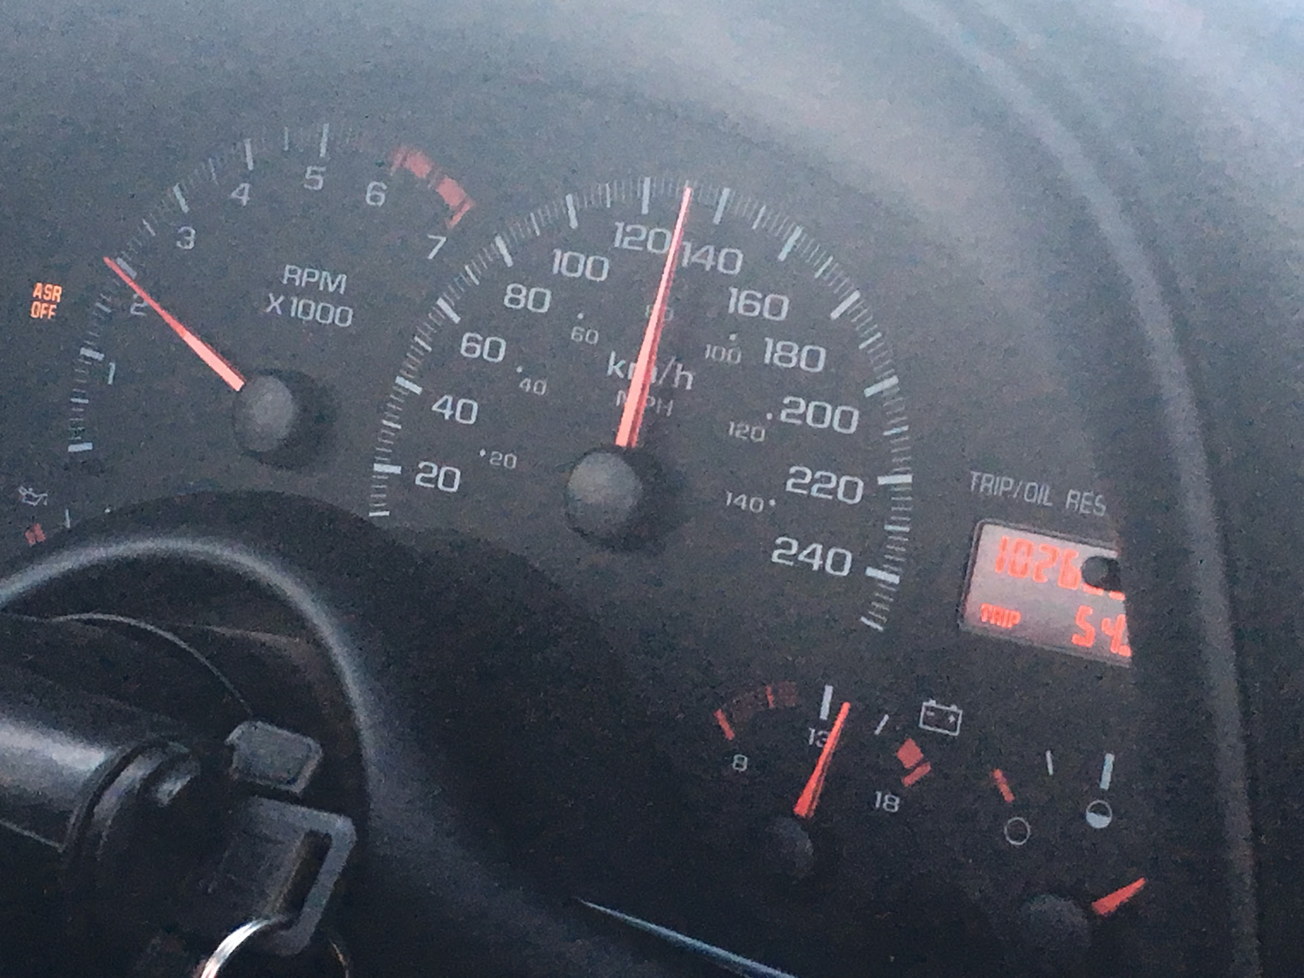
Summer of 2018
Notes:
https://www.youtube.com/playlist?list=PL6l1jb2FC4jHgfT9a41bTxdktgeRcR_FZ&disable_polymer=true

Slide 3
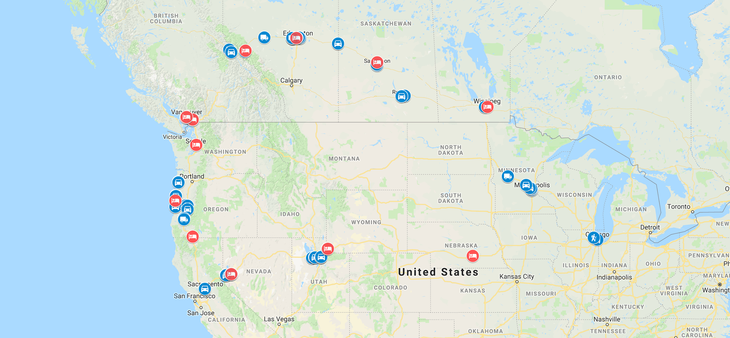
Map

Slide 4

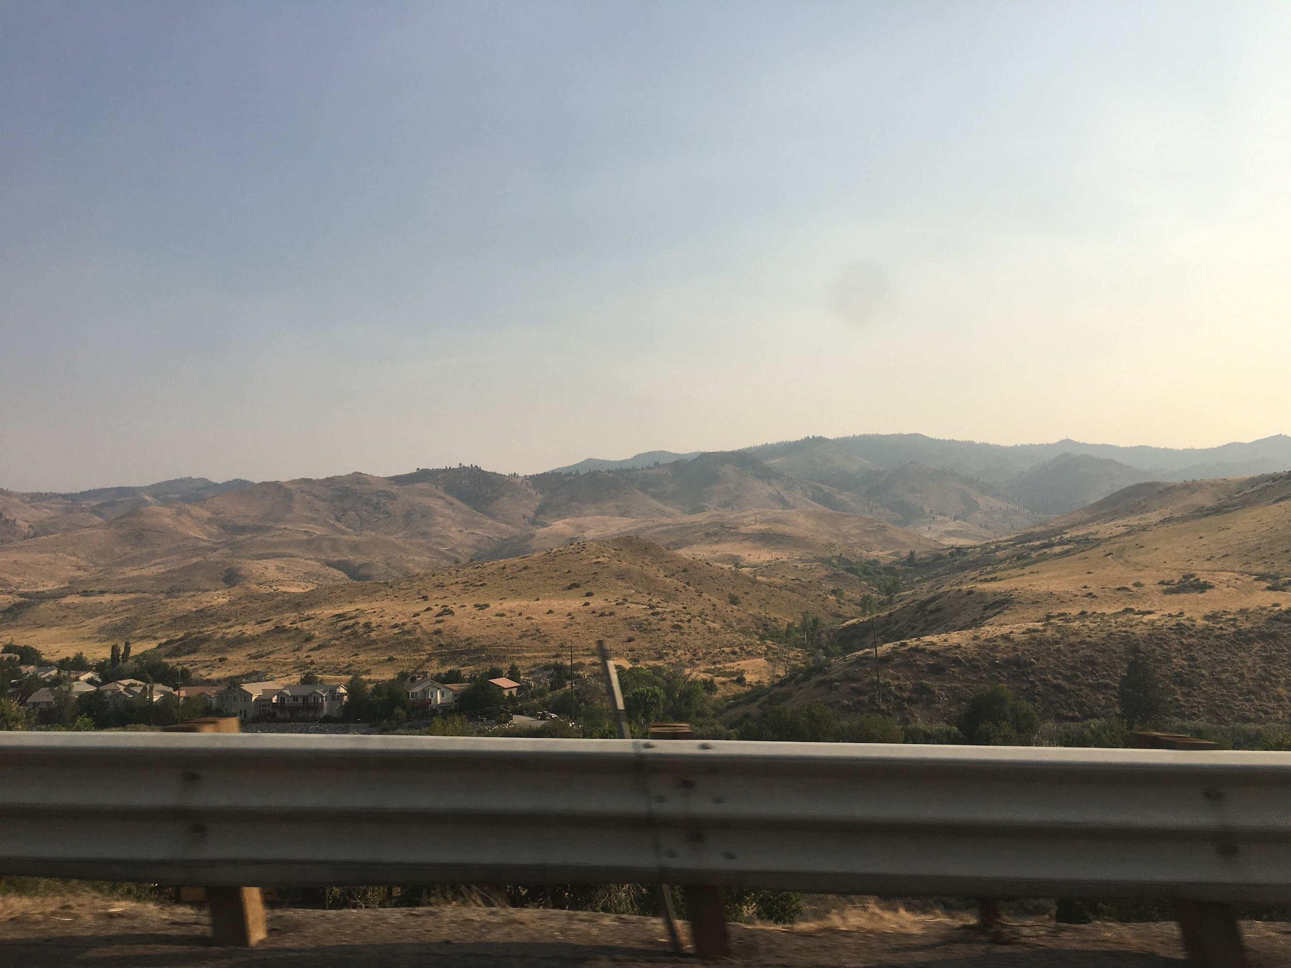
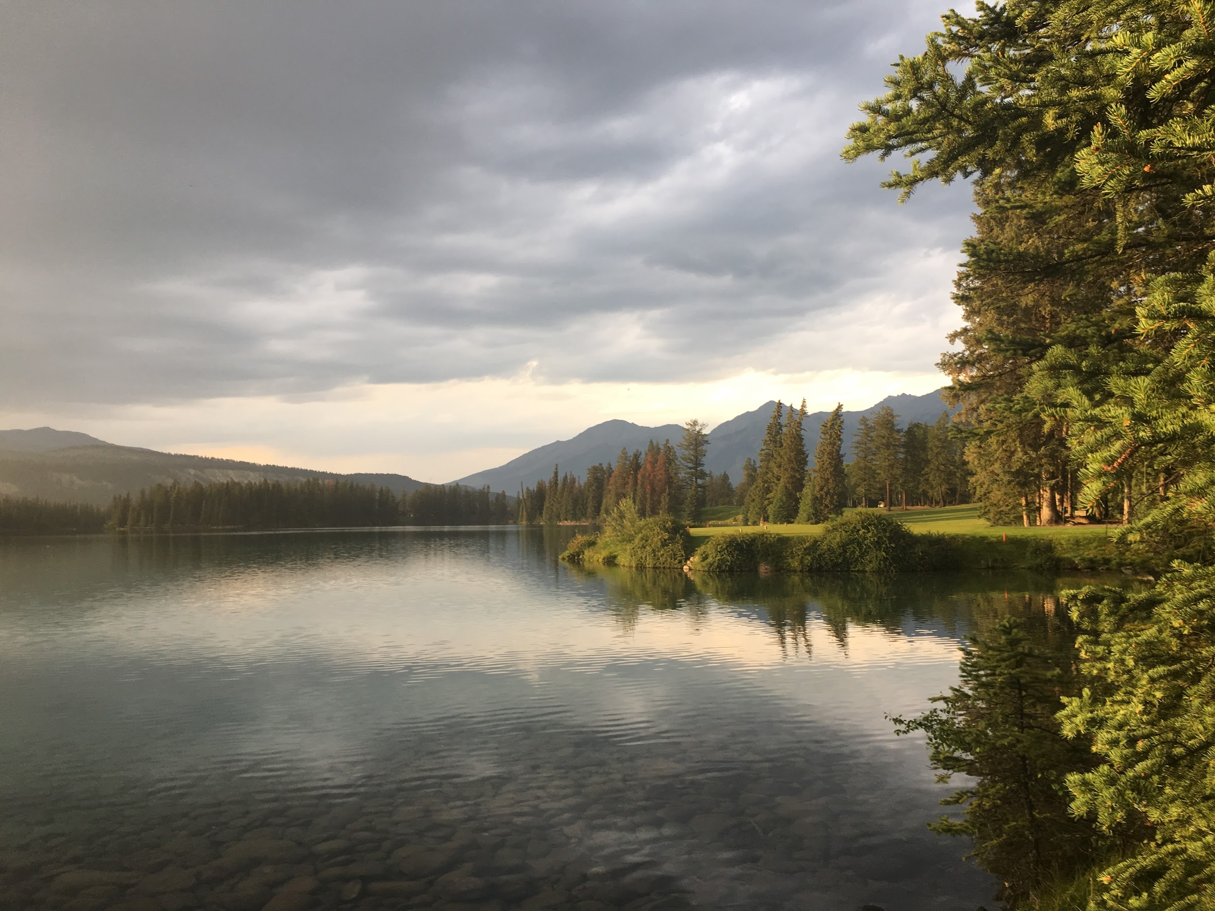
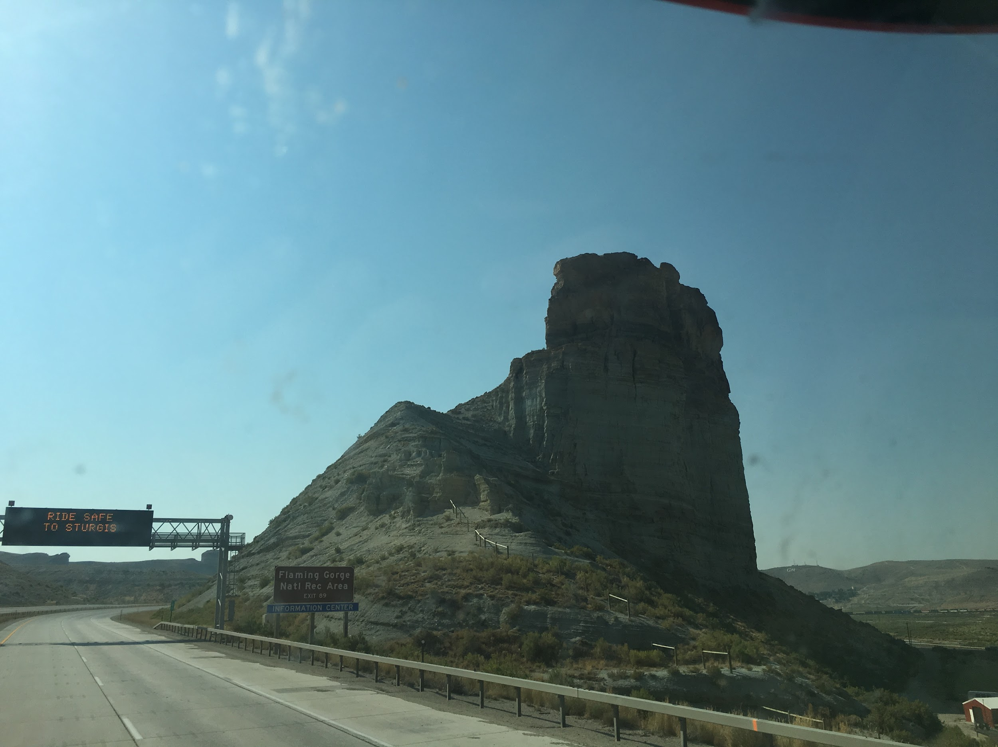
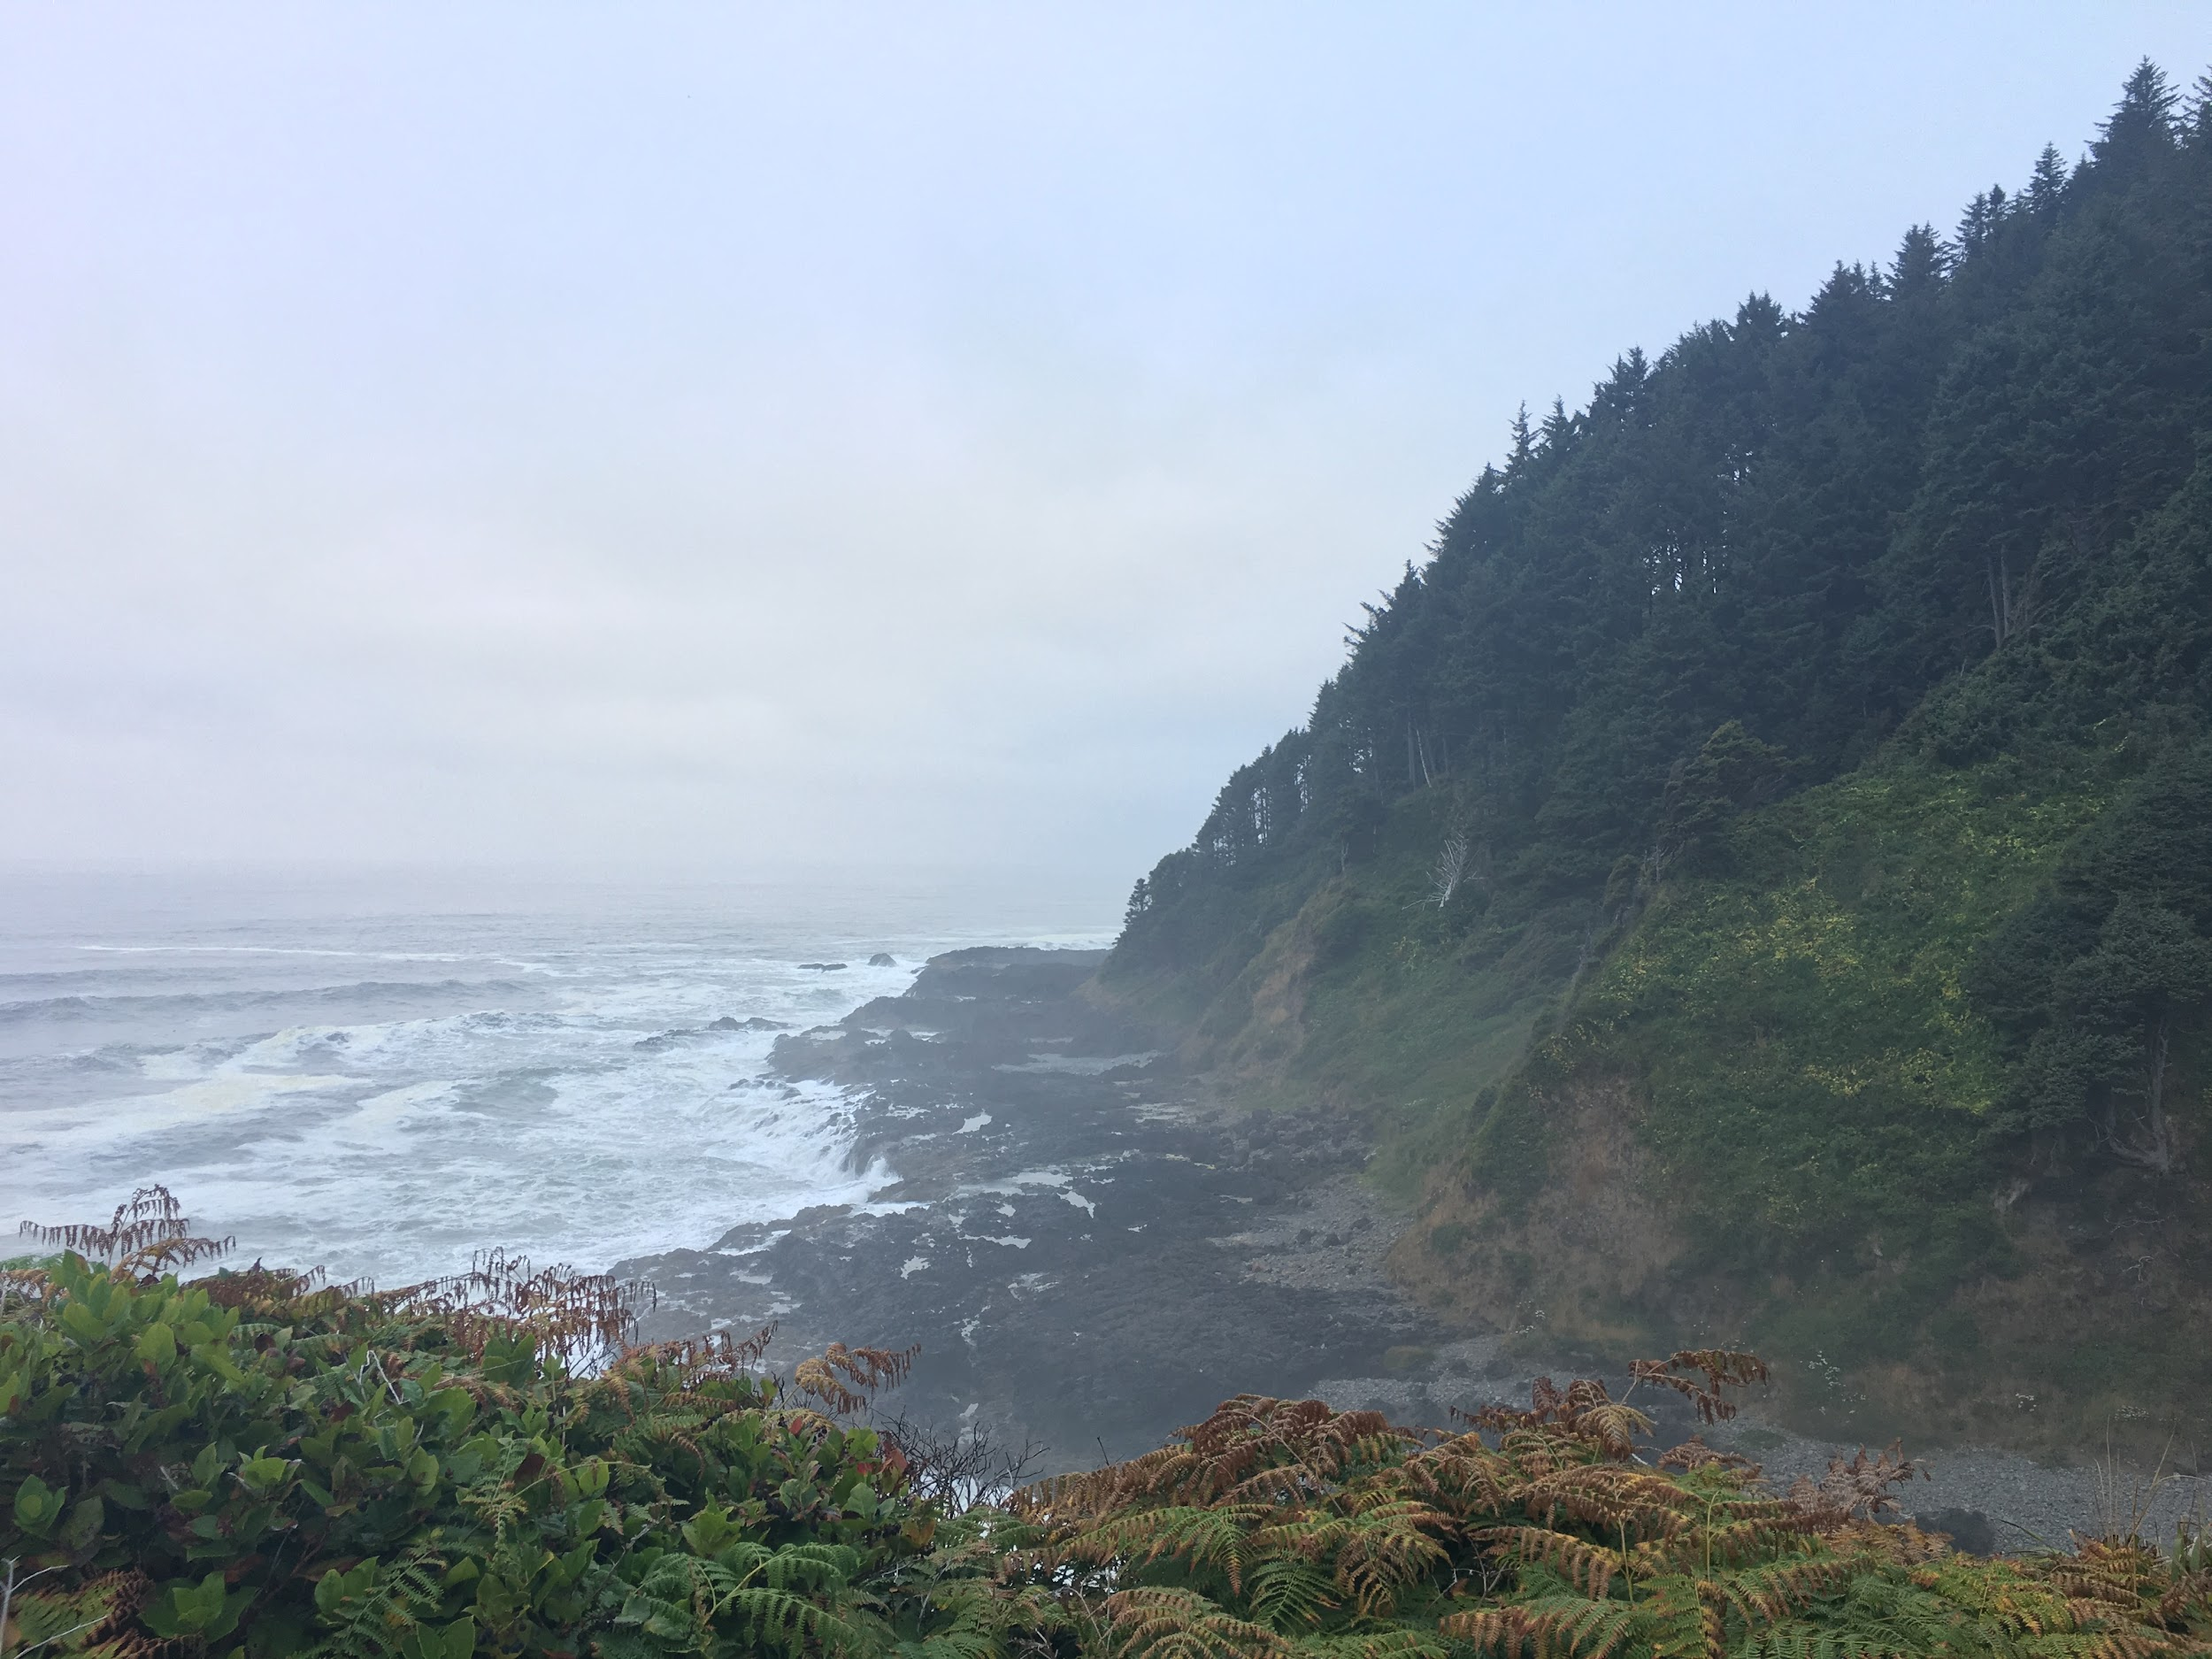
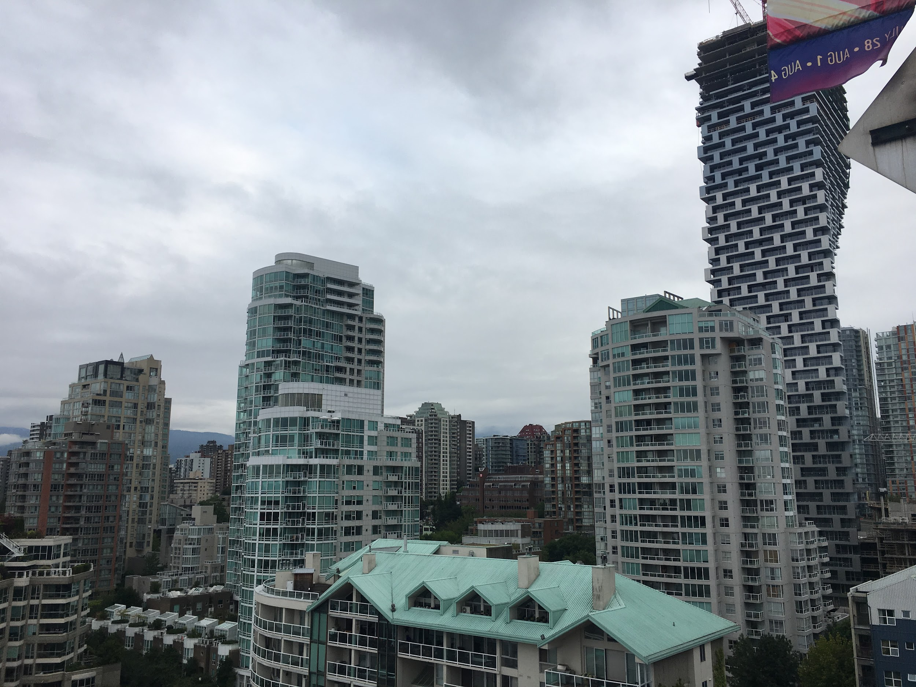
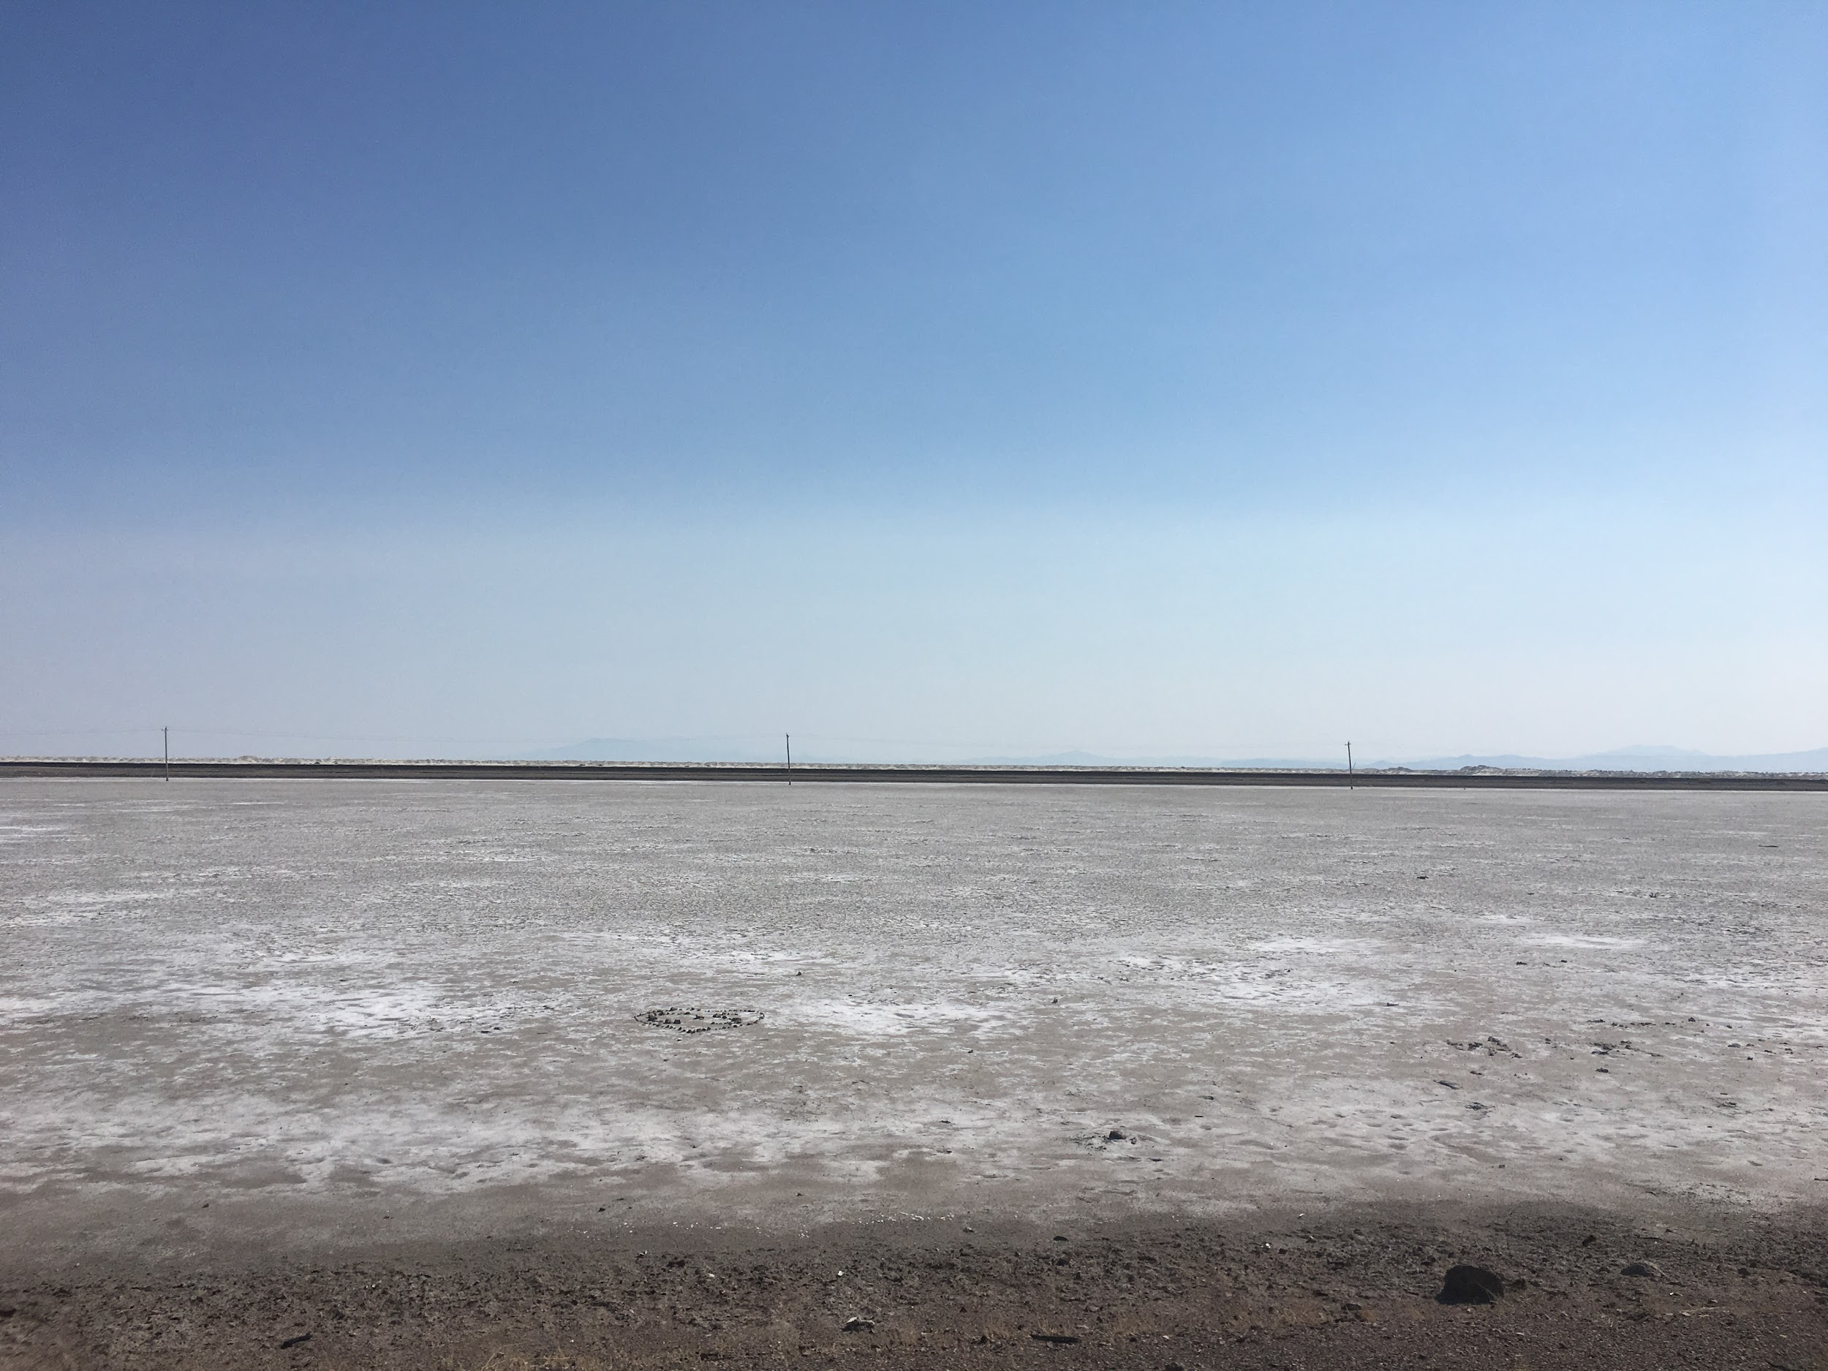
Sceneries

Slide 5
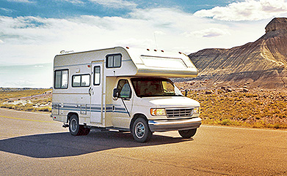

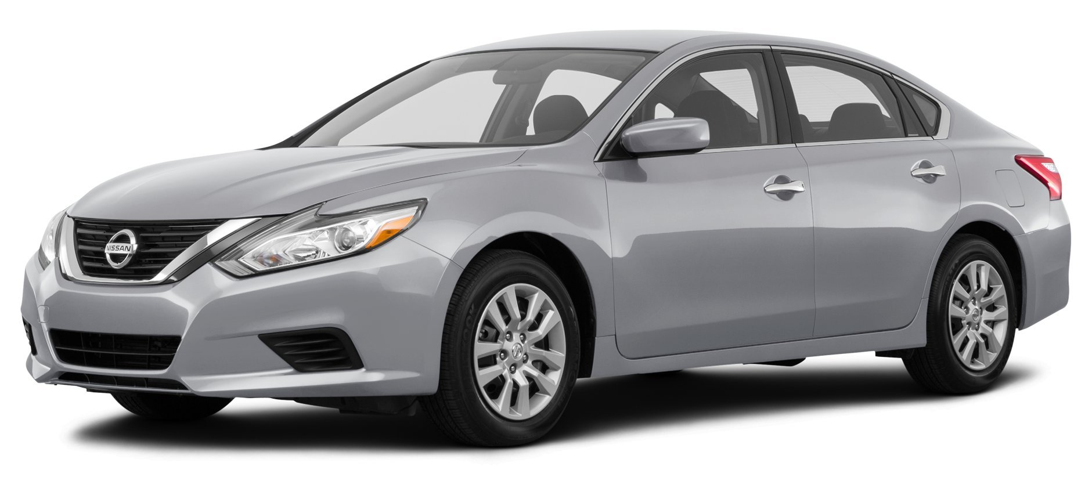
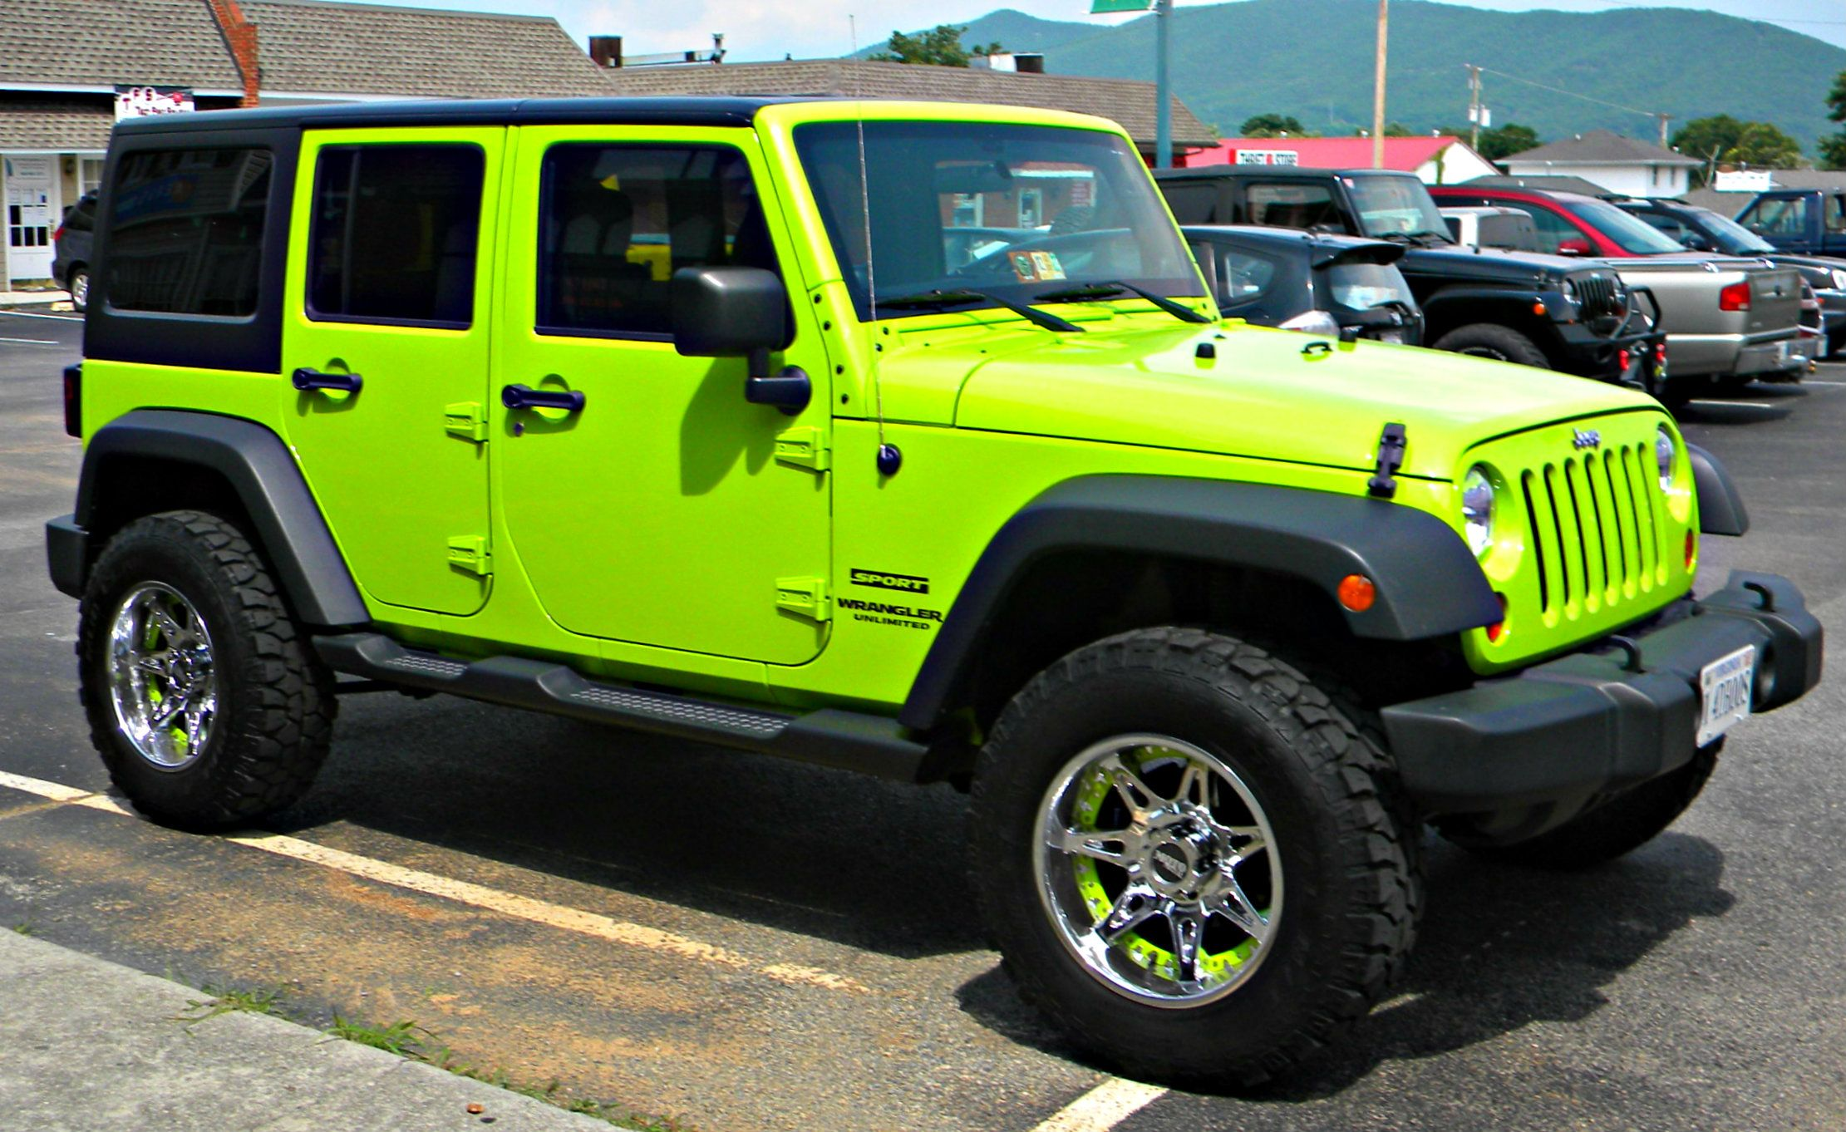
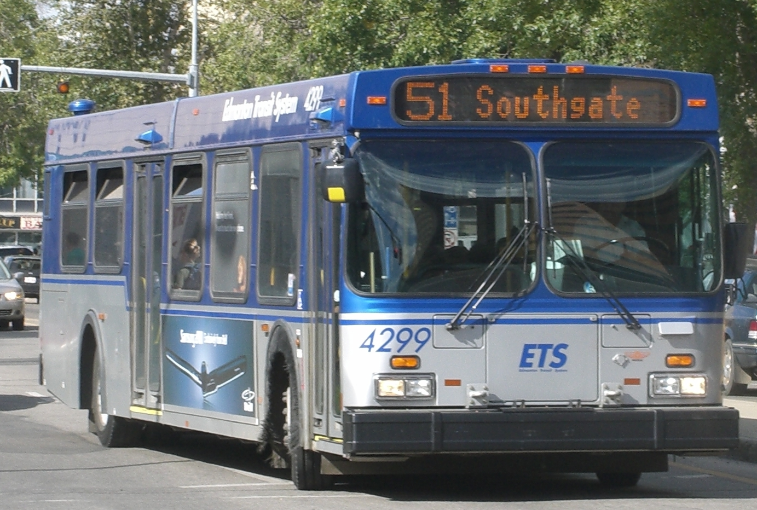
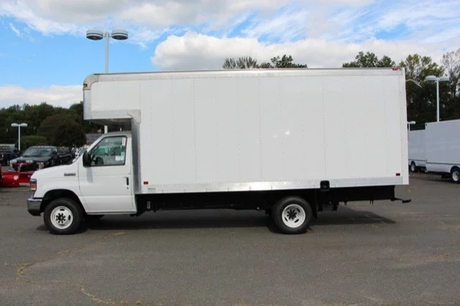
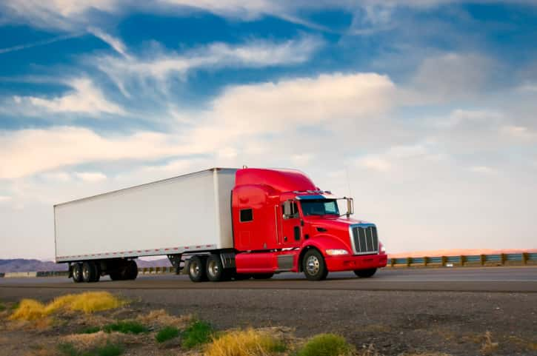
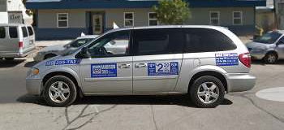
Vehicles
Car
RV
FedEx Truck
28
1
2
Jeep
City Bus
Firetruck
1
1
1
Taxi
Box Truck
Semi-Truck
1
2
5

Slide 6
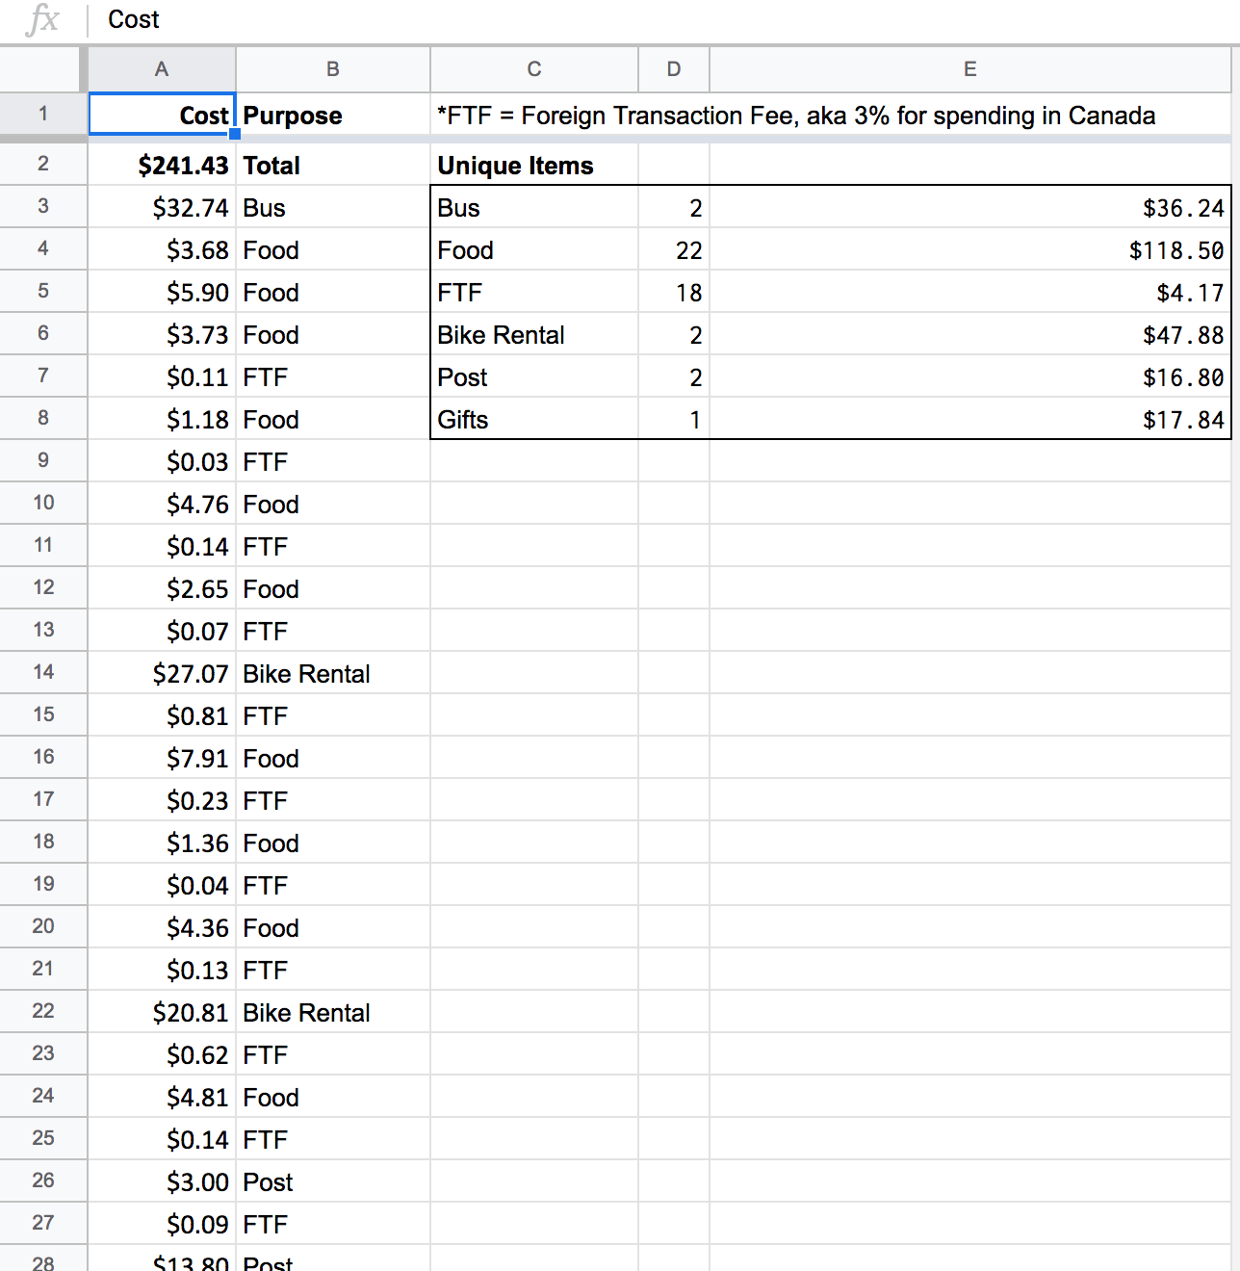
Costs

Slide 7
How to Hitchhike

Slide 8
Federal Law
From the United States Uniform Vehicle Code
11-507: “No person shall stand in a roadway for the purpose of soliciting a ride.”
Roadway definition: "Roadway" means that portion of a highway improved, designed or ordinarily used for vehicular travel, exclusive of the sidewalk, berm or shoulder.
https://iamtraffic.org/wp-content/uploads/2013/01/UVC2000.pdf

Slide 9
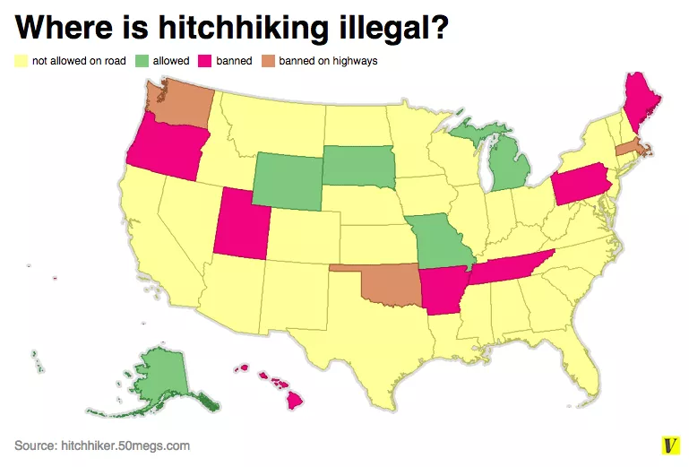
Legality Map
https://www.vox.com/2015/6/8/8737623/hitchhiking

Slide 10
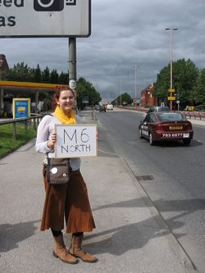
Rules of the Thumb
Happiness > Desperation
Wear clean and light-colored clothes
Only try to get rides when there’s daylight
People are too busy and driving short distances in cities
Possibly better to turn down short rides

Slide 11


Getting Rides
Age
Physical Size
Gender
Number of People
Weather/Temperature
Thumb vs Signs vs Asking
Eye contact

Slide 12
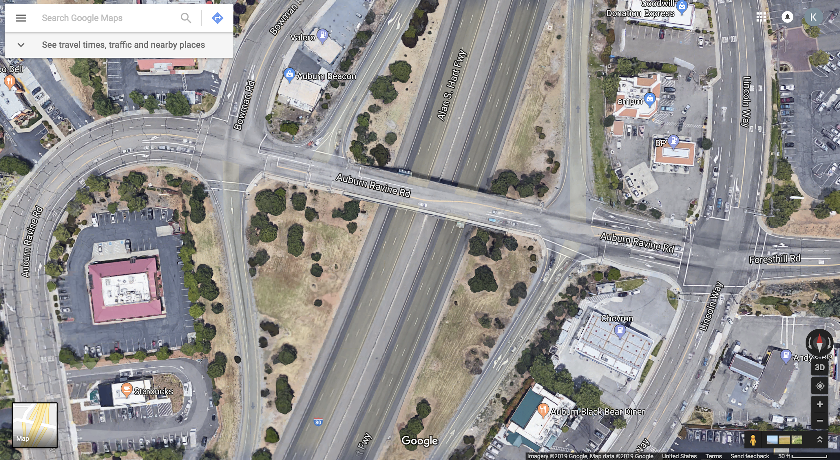
Analysis: Oroville, California

Slide 13
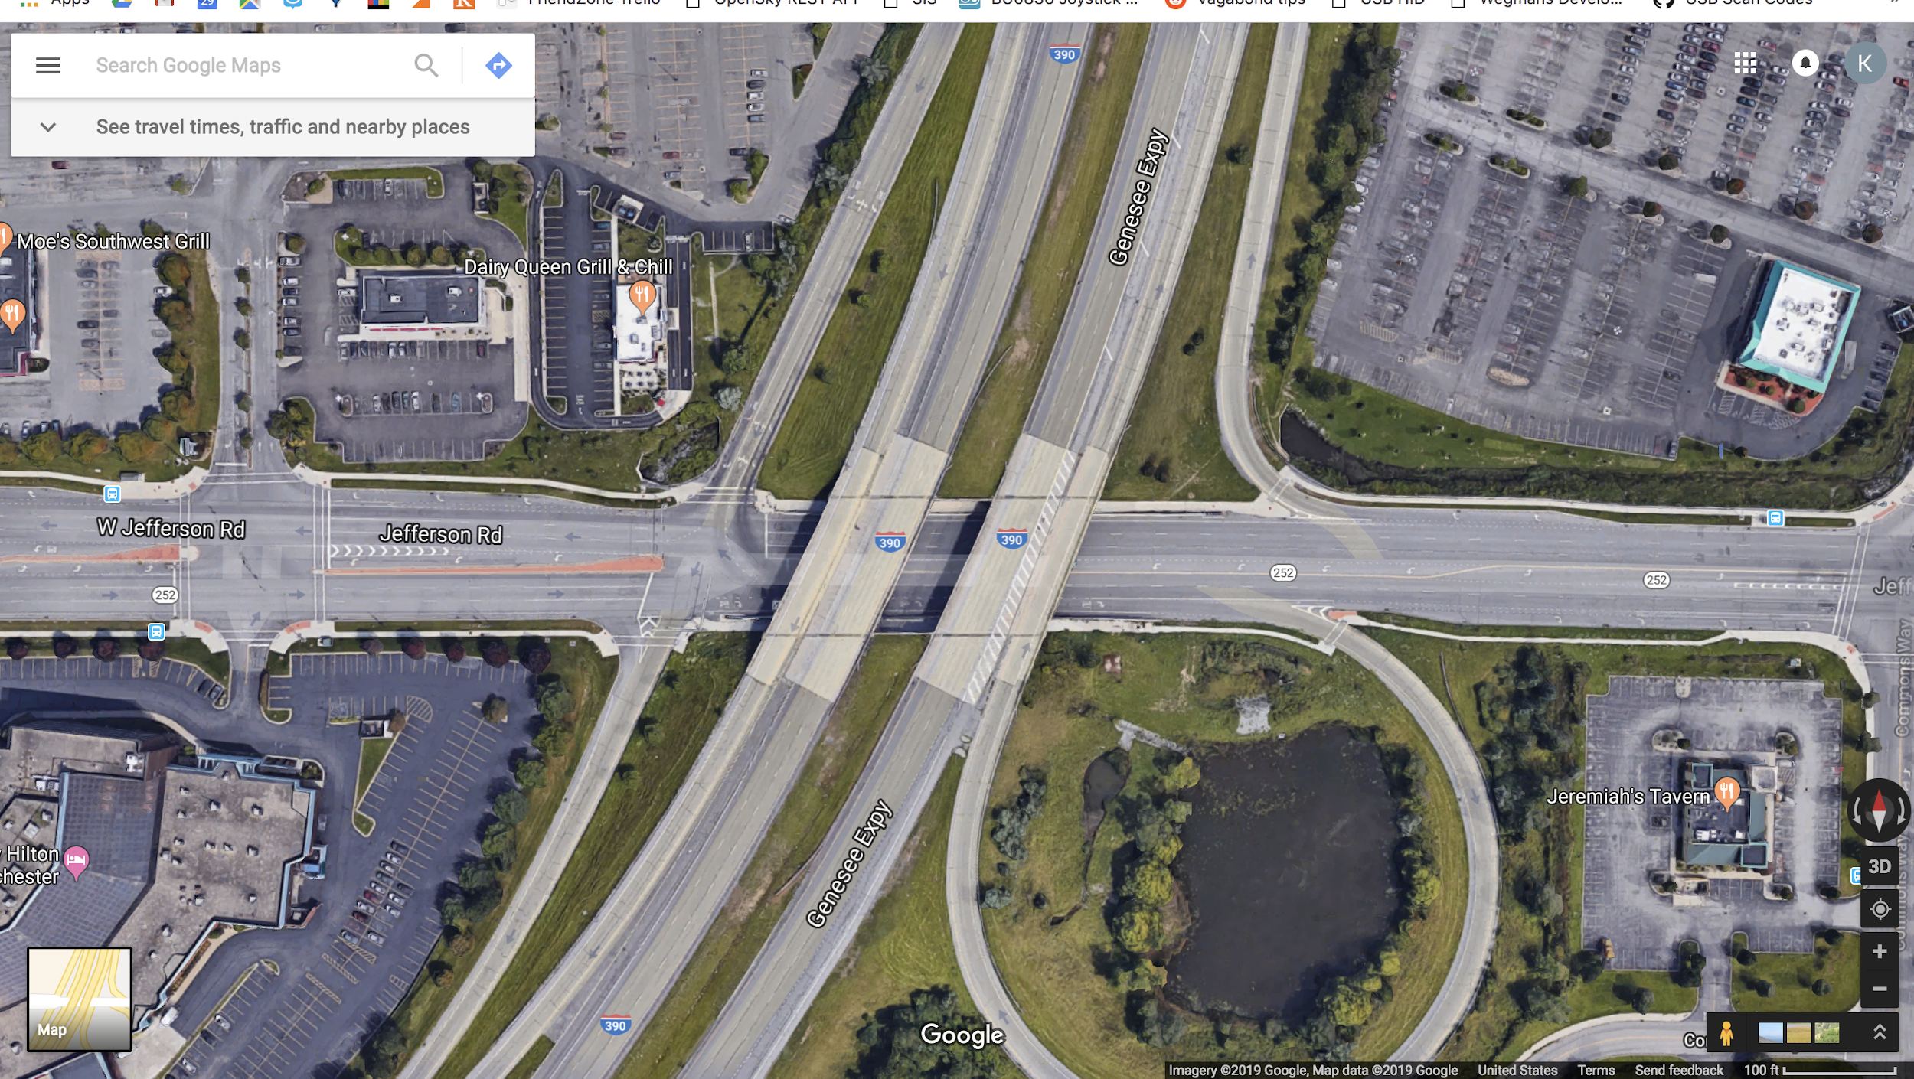
Analysis: Henrietta, New York

Slide 14
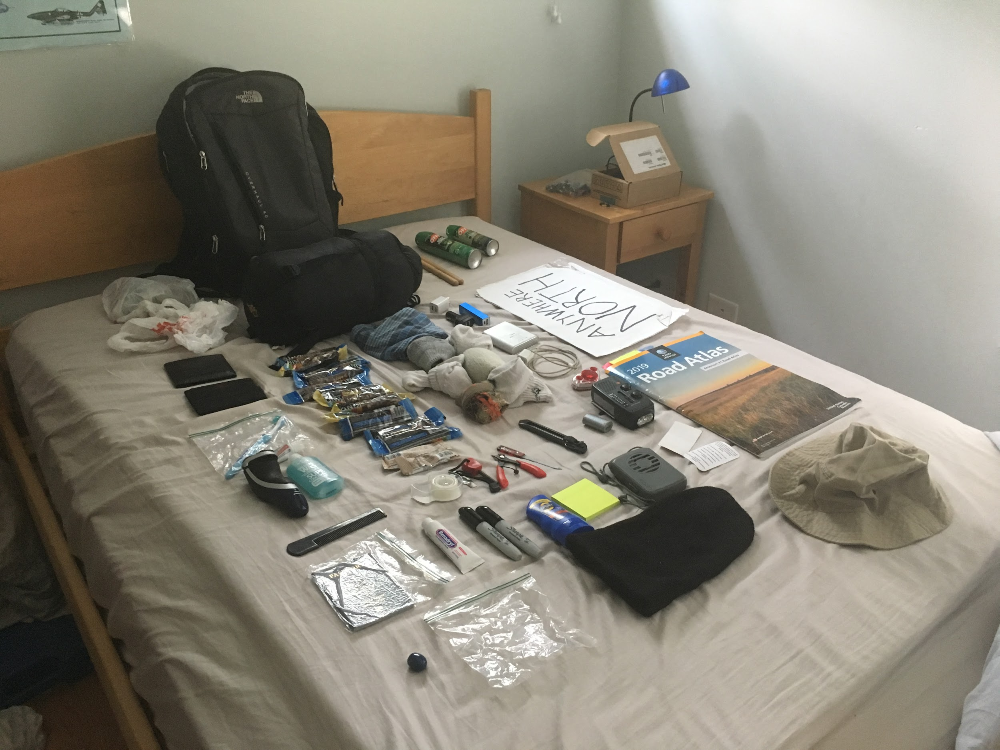
Things to Bring

Slide 15
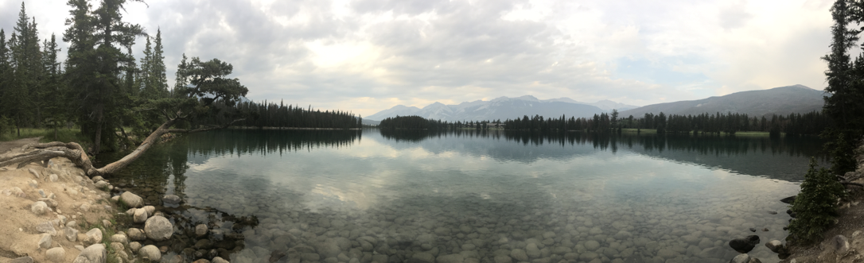
Adventure Awaits

Slide 16

Kenny Kim, Summer 2018

